Slide 1

Enhancing Energy Consumption Predictions Through Driving Pattern Analysis
Yonatan Goldstein
Mentor:
Oren Elisha
Industry Partner: Amir Baruch
Notes:
Hi, I'm Yonatan Goldstein. My mentor, who contributed a lot to the project, was Oren Elisha and my Industry Partner was Amir Baruch.

Slide 2

Notes:
The project was done for Stellantis, which sounds like a niche space agency, but actually is the 4th biggest car manufacturer in the world, with brands we all know like Citroen, Peugeot, Fiat, Jeep and even Maserati.

Slide 3
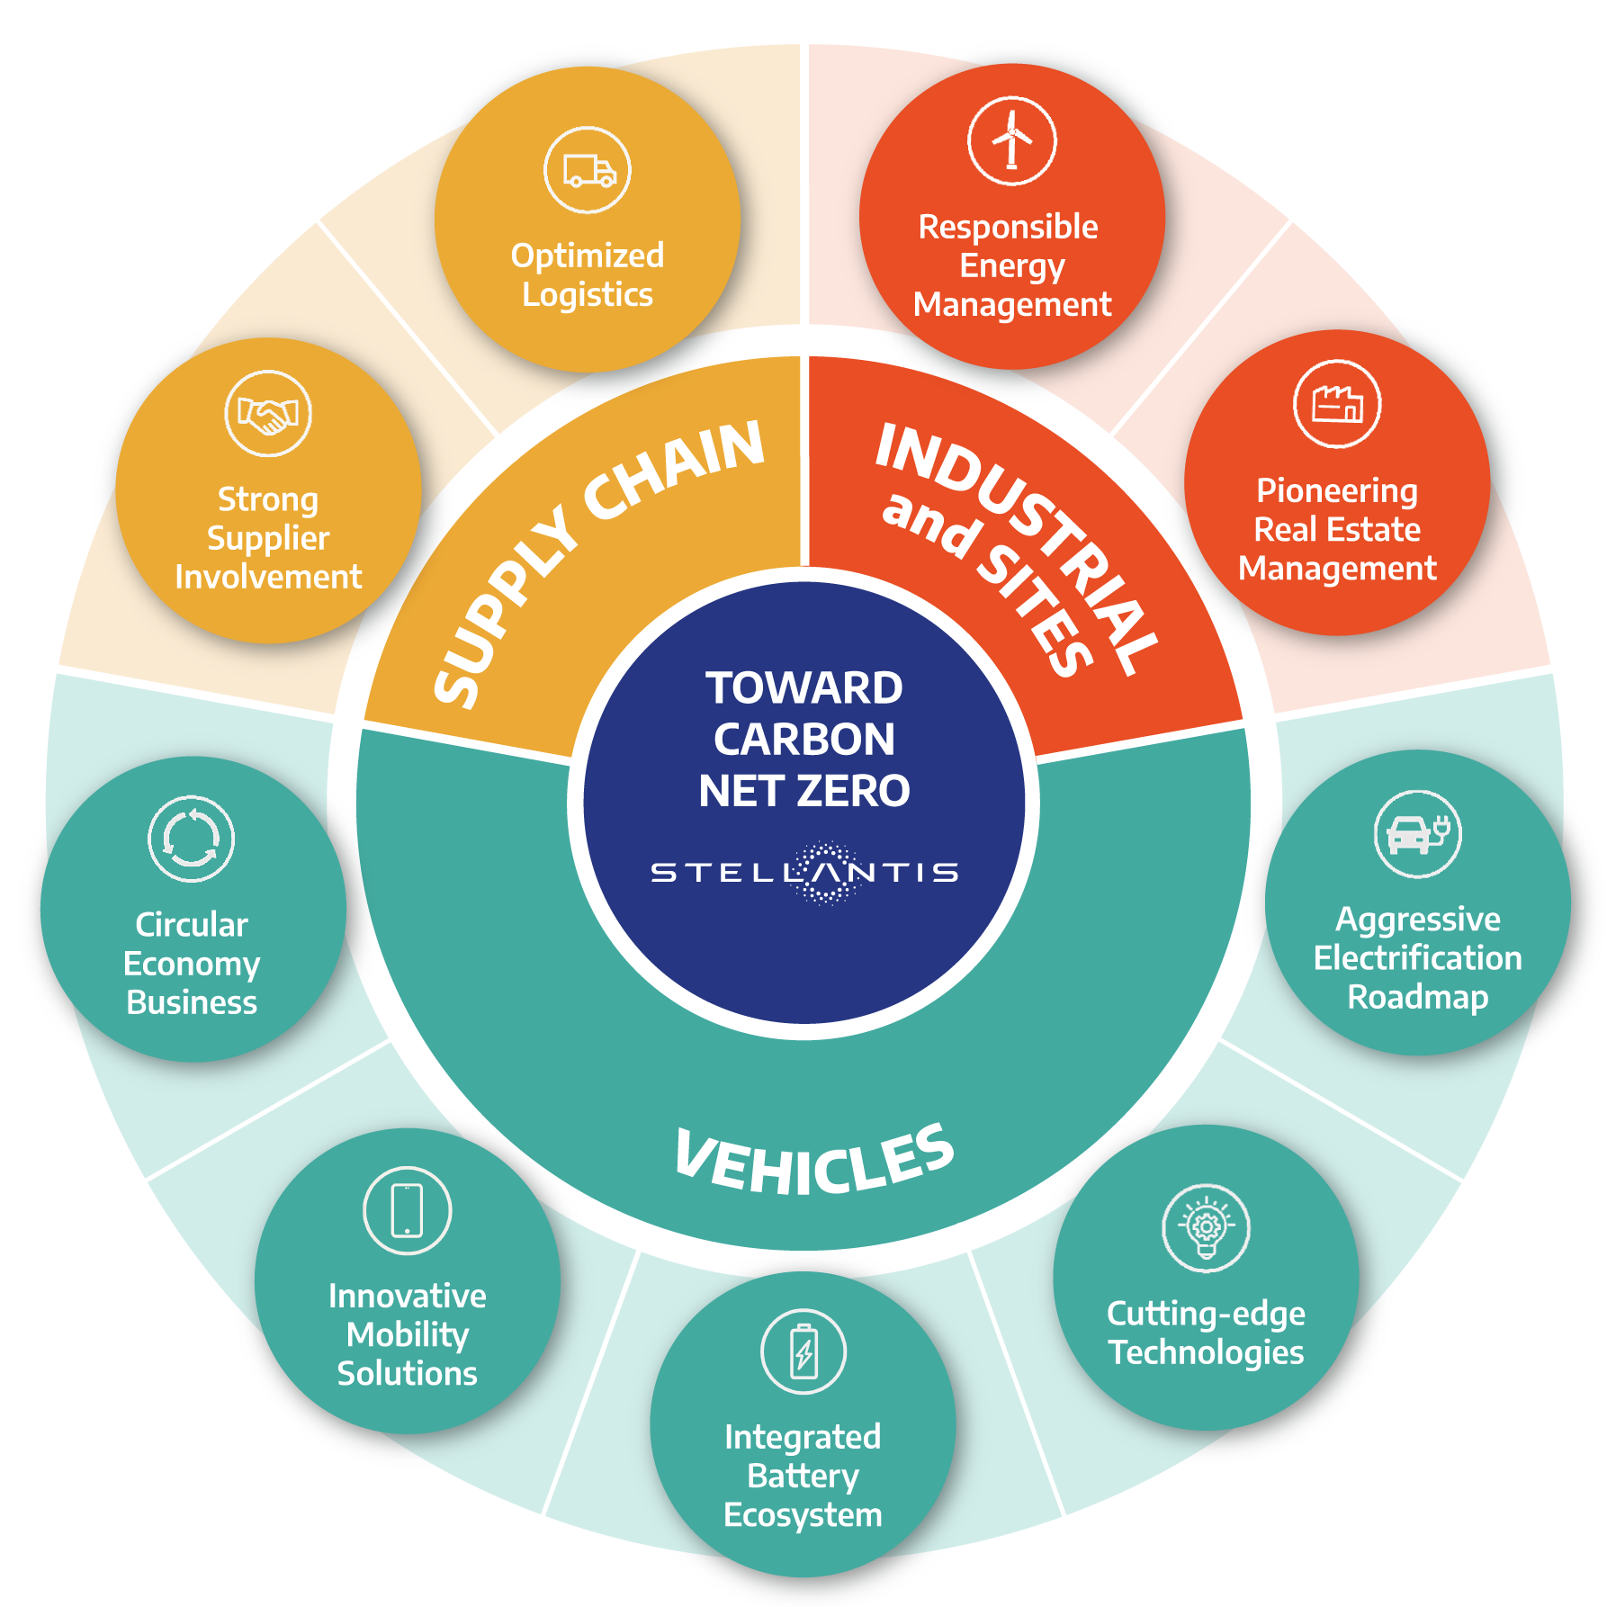
Notes:
Stellantis is guided by its Dare Forward initiative, which is a strategic plan to achieve carbon net zero by 2038.
Accordingly, Stellantis is investing a lot of research effort in improving its battery electrical vehicles (or BEVs) driver experience.
Specifically, I worked with the EV & NAV team that is focused on improving the navigation experience for BEV drivers.

Slide 4
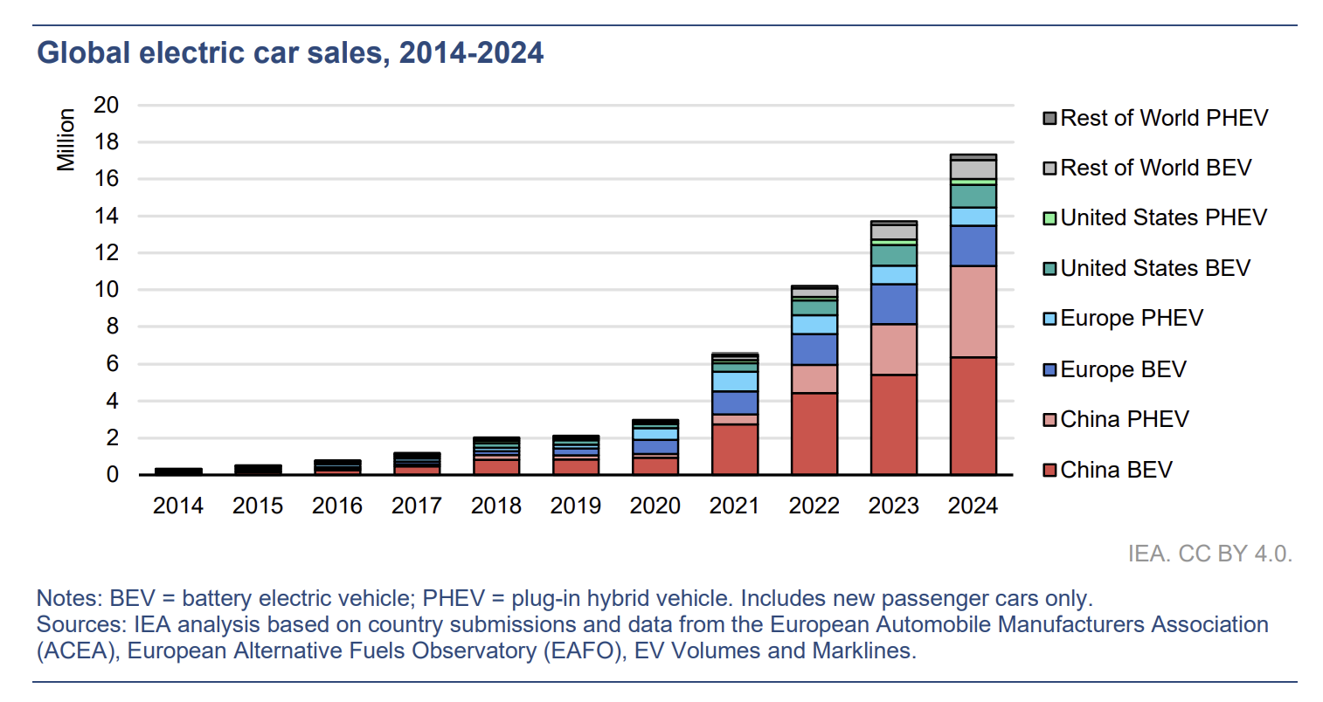
EVs are on the rise
Notes:
Indeed, as we all feel and see around us, the global demand for EVs around the world is rapidly increasing. And China is leading the curve.
Additionally, report by Bloomberg published two months ago, predicts nearly 22 million global passenger EV sales this year, a jump of 25% from 2024. So we can see that the trend is continuing.

Slide 5
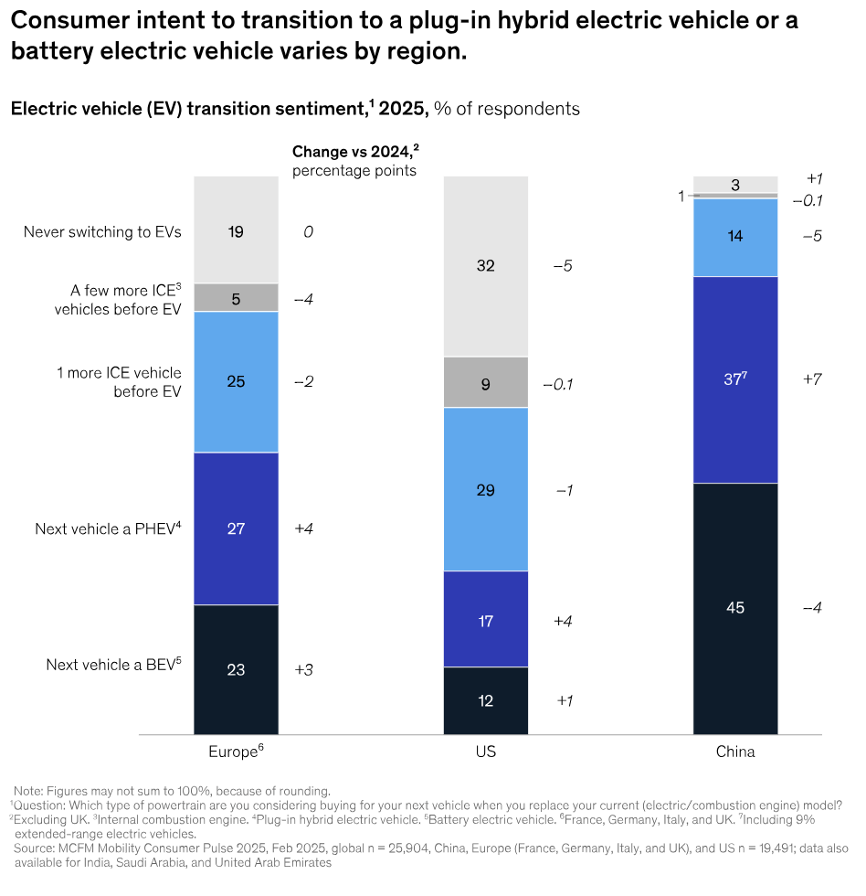
Many consumers are still reluctant to switch to EVs.
Notes:
Yet many consumers are still reluctant to buy Evs, as we can see here by looking at the top half of each bar, showing that most consumers do not intend to switch to EVs, at least not in the west. These plot are from a McKinsey report published earlier this year.

Slide 6
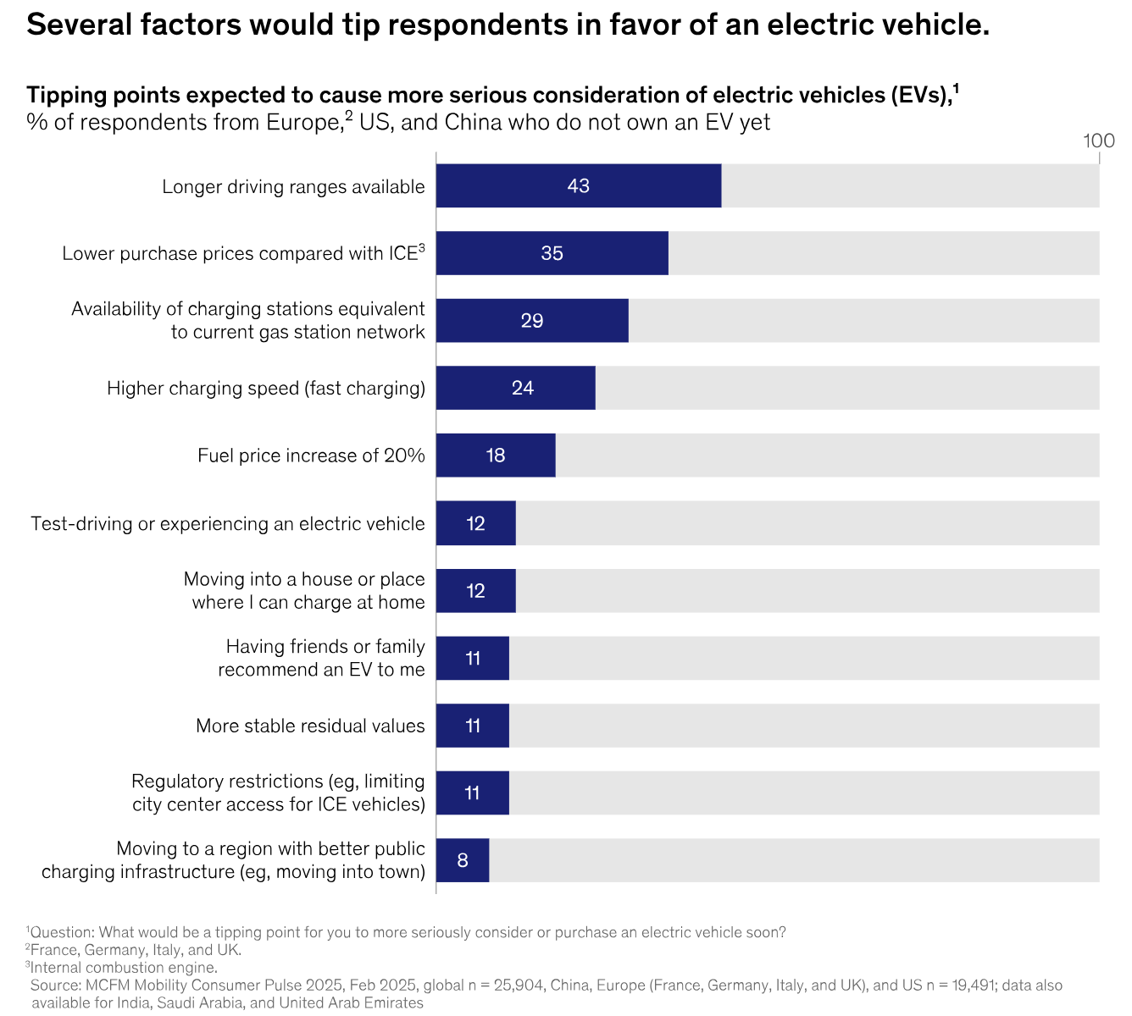
Range anxiety is the leading factor.
Notes:
The leading factor that prevents consumers from switching to EVs is range anxiety- the fear of running out of battery charge before reaching the destination or finding a charging station.

Slide 7
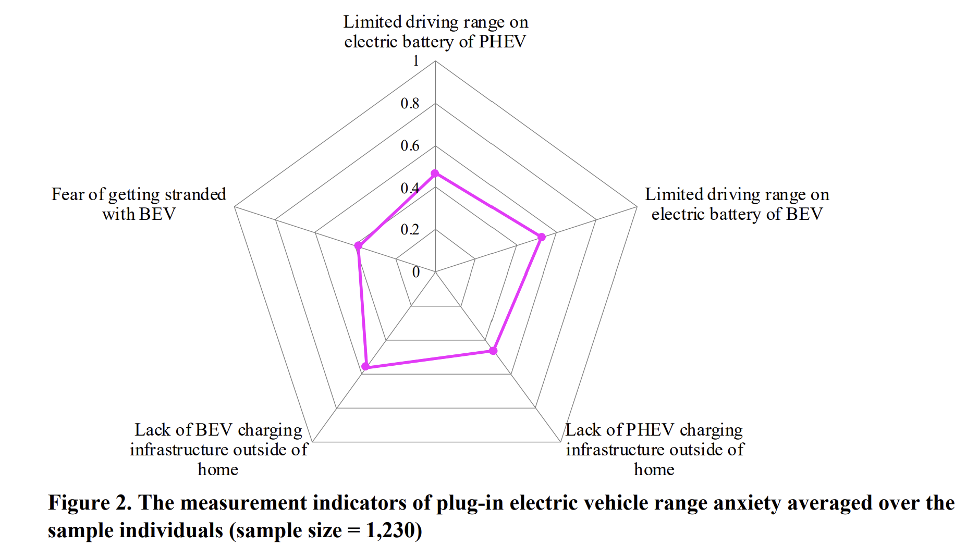
Nazari, F., Mohammadian, A., & Stephens, T. (2023). Exploring the role of perceived range anxiety in adoption behavior of plug-in electric vehicles. arXiv preprint arXiv:2308.10313.
Notes:
A relatively recent study found that 0.4 of responders fear of getting stranded with BEV. So, we can see that is a serious and common concern.

Slide 8
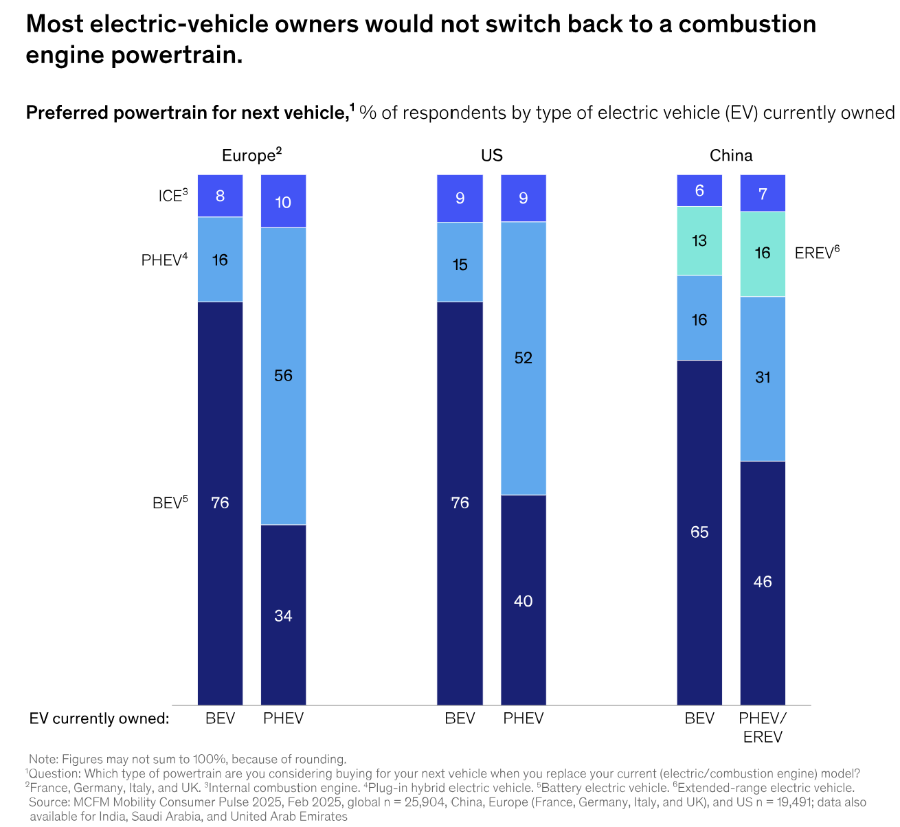
Once you go EV you never come back.
Notes:
Importantly, once consumer overcome the range anxiety obstacle and purchase their first EV, they tend to not switch back.

Slide 9
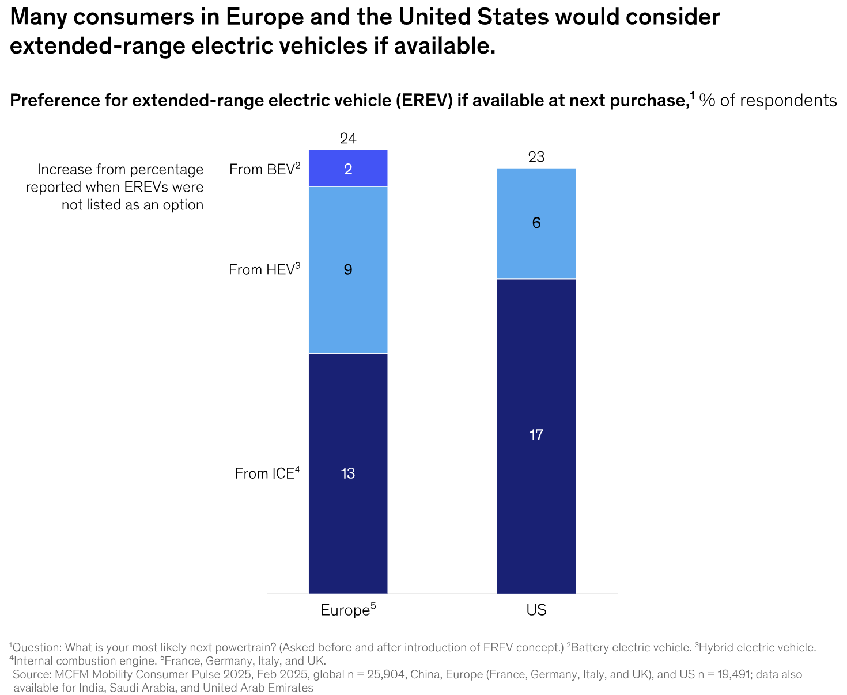

Slide 10

State of Charge Prediction
Accurate state of charge (SoC) estimations lower range anxiety
Driving behaviors patterns can dramatically affect the accuracy of SoC predictions.
Stellantis' current production system does not account for these patterns.
Notes:
One of the major factors contributing to range anxiety among EV drivers is inaccurate estimations of State-of-charge (SoC), which is the amount of electrical charge remaining in a battery, expressed as a percentage of its total capacity. Importantly, improving the accuracy of SoC estimations can alleviate range anxiety.
Studies have consistently shown that personal driving patterns, behaviors, characteristics, or styles (such as aggressive acceleration, frequent braking, or cautious speed maintenance) can dramatically affect the accuracy of SoC predictions. As driving style influences energy consumption rates, battery discharge patterns, and overall SOC variability.
Yet Stellantis' current production system does not explicitly account for driving behavior patterns.

Slide 11

Project Goal
Incorporate driving behavior patterns to improve SoC predictions accuracy.
Single prediction, at trip start, of the SoC at the destination.
Notes:
Therefore, the goal of the project is to test weather incorporating driving behavior patterns, from driver’s completed trips, can improve SoC predictions accuracy.
Specifically, we focused on a single prediction, done at the start of the trip, to the SoC at the destination.

Slide 12
Dataset
Column Name | Example Unique Values
manufacturer | PEUGEOT, CITROEN, DS
car_model | 208 V2 (P21), SPACETOURER / JUMPY 4 (K0)
empty_weight_kg | 1455, 1548, 2086
battery_type | L2 640 60AH EF 640 EN, L2 640 640 EN
trip_id | eec8dc43-153a-…, 1cf20e60-e008-…
timestamp | 2024-03-12 09:04:14, 2024-03-12 09:05:13
outside_temp | 13.5 12.5 13.0
battery_health | 98, 90, 92
odometer | 18846.5, 18846.9, 18847.4
location (Uber’s H3) | 6225069400206… ,6225069400204…
SoC (🎯) | 100.0, 99.3, 98.9
speed_array | [33.3, 34.07, 35.0, …], [56.55, 51.28, 45.34, …]
altitude_array | [152, 153, 153, 154, …], [153, 151, 149, 152, …]
Stellantis’ BEVs sensors.
3,000 unique trips.
12/2023- 03/2024.
13 European countries.
1 row per minute.
Speed 1 per sec.
Altitude 1 per 10 sec.

Slide 13
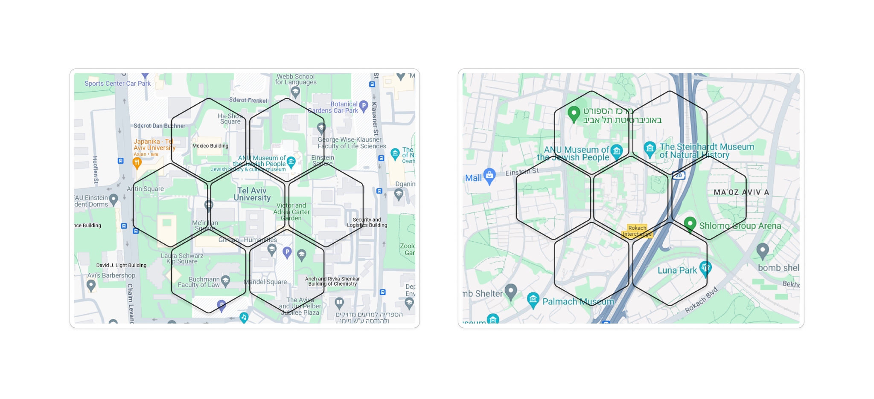
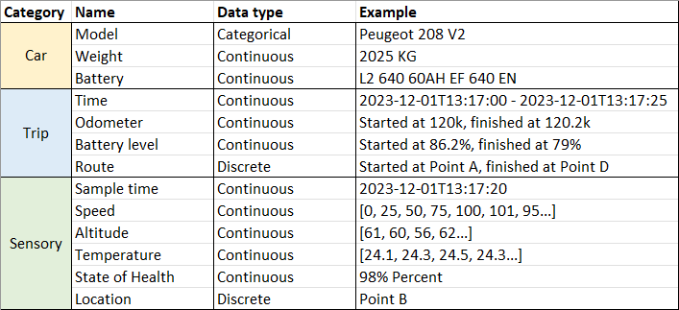
Dataset Overview
From car sensors
A single table with more than 10 million rows (13505184)
Samples from car trips - every minute
Features categories: car, trip and sensory
Time period: 4 Months - November 2023 to March 2024
Car models: Peugeot, Citroen, DS …
Location: France*
Target: State of Charge (0.1% sensitivity)
Notes:
Our dataset was a single table containing Sensory + metadata from Stellantis’ BEVs.
Data- single table, number of trips, time duration, from.
Main Features
Sampling rate
a short overview of the data
we have a lot of data - more then 10M rows
every row is a segment of a trip representing 1 minute interval.
the locations were given as an Uber H3 hexagone. (it is Uber’s grid system)
target feature is the state of charge (SOC)
the data is comprised by 3 categories: car info (model, brand, weight etc..), trip info (id, start-end (SOC, odometer, ..)) and sensory data that is collected during the trip (speed, altitude, temperature and of course the battery SOC)

Slide 14
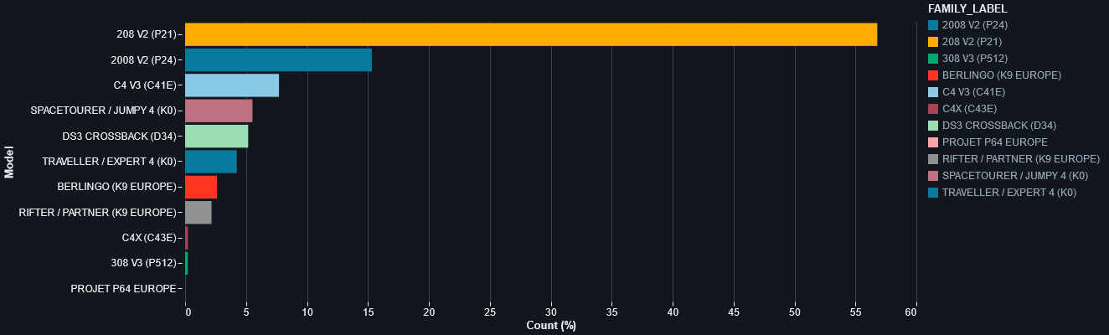
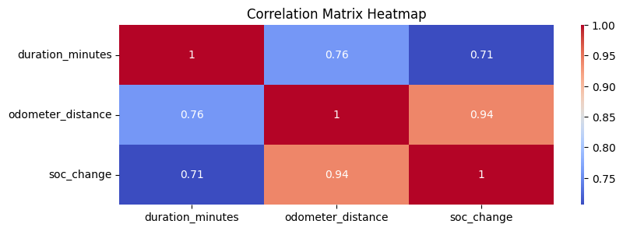
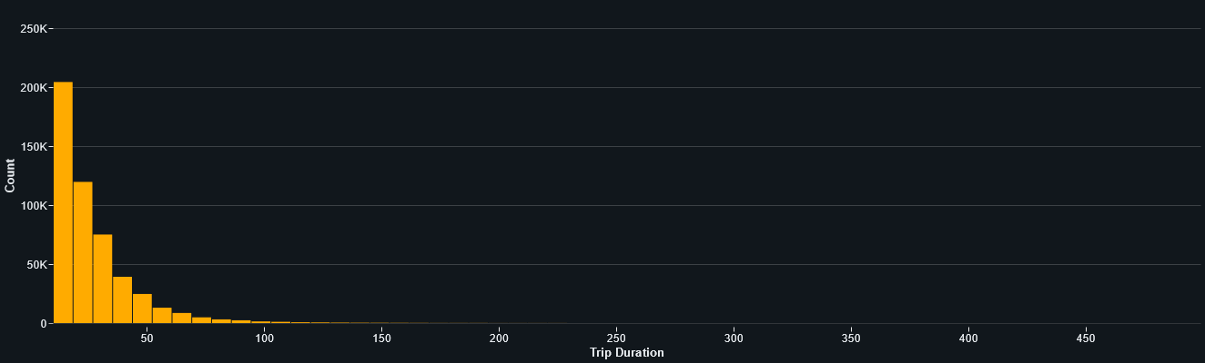
EDA Main Findings
High correlation, heavy skew and low variance
Skew
New cars and similar State-of-Health
Over-represented car model
Short trips in both time and distance
…
Correlation
Car and battery
Car and weight
Distance and time
…
Low variance
Trip were collected at the same season
Same temperatures
no other weather info
Notes:
as you know, no data set is perfect
the data was a bit skew regarding some features - only new cars with excellent SOH, one car model dominant the data, and most of the trips were under 10 minute (meaning they were relatively short trips)
some features were highly correlated. like the CAR feature (or example battery type, car weight) and obvious correlation between time and distance.
in addition, measurement spans across four month of winter, which means we have low variance in the temperature.

Slide 15
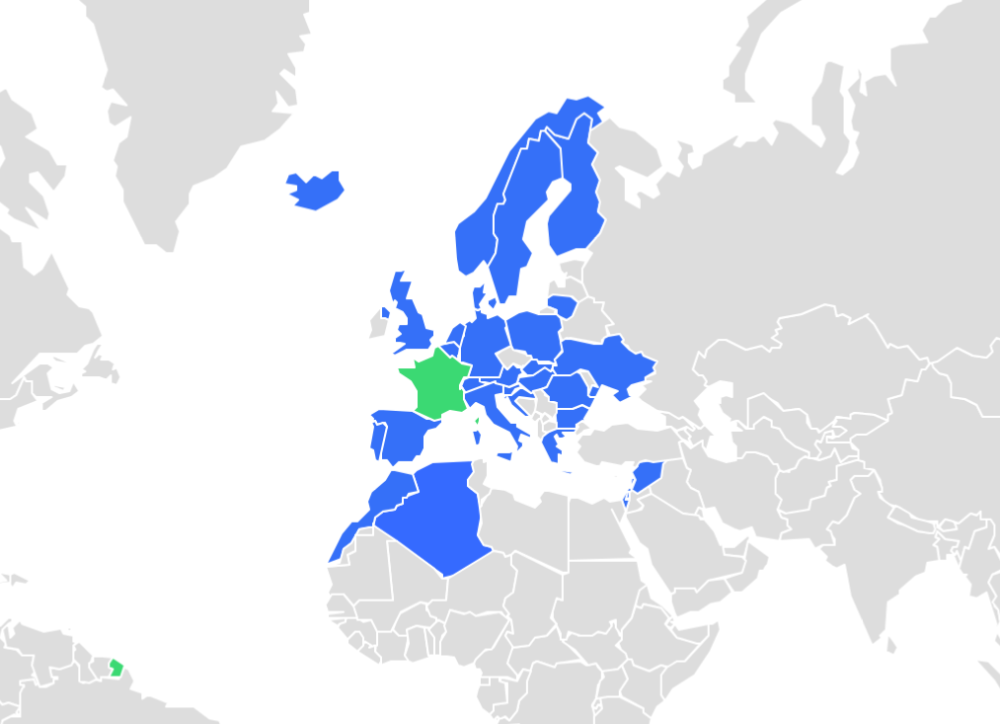
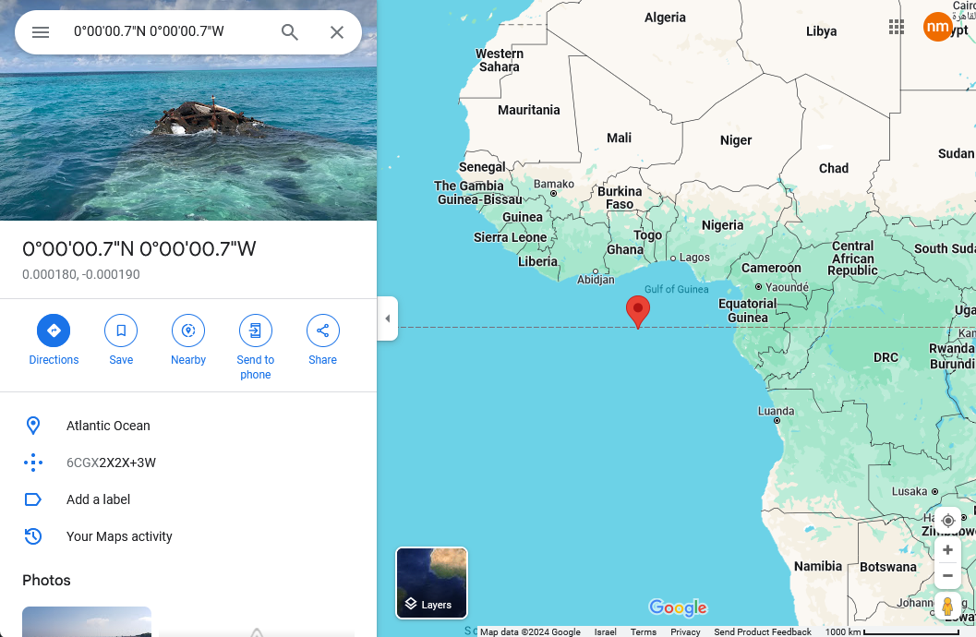
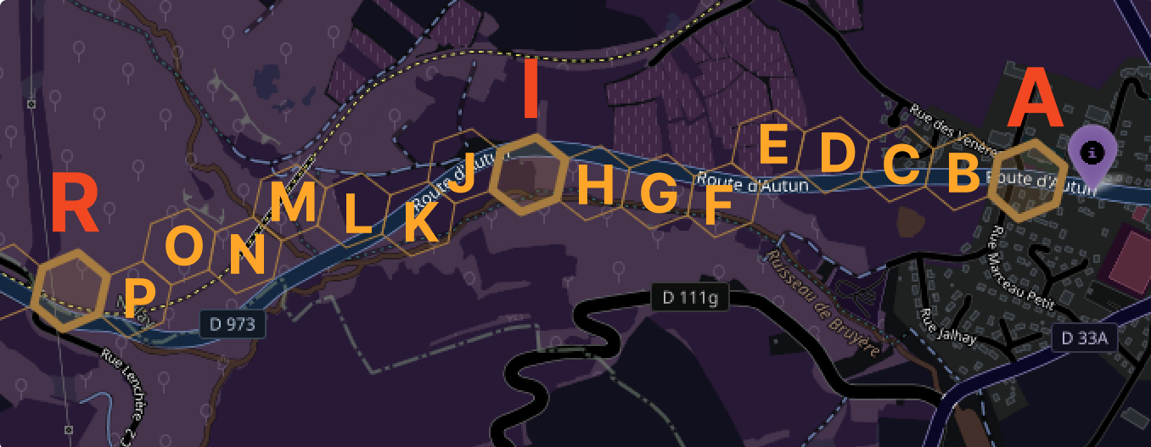
EDA Main Findings
Locations
Sparse locations
Missing trip segments (!)
Globalization (not a political stance)
Reading errors or lost treasure
Trips in countries outside of France
Where did we go through?
Lost at sea
Notes:
we noticed most hex (location) appear only once in the data. trips only contained some of its segments (hexs) , not a continuous overlapping segments we found that the most recurrent hex in the data was located deep under the atlantic ocean west of Africa data was collected based on cars that were sold in france, but it presents world wide trips and not only from France

Slide 16
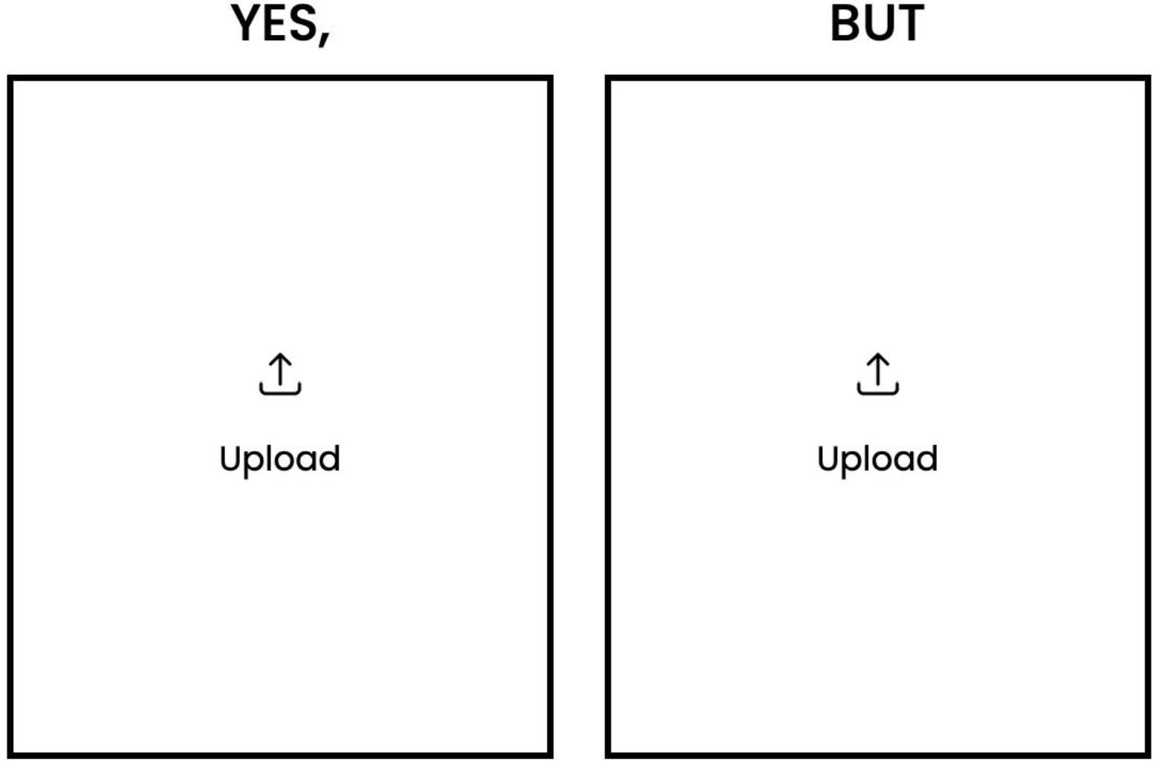
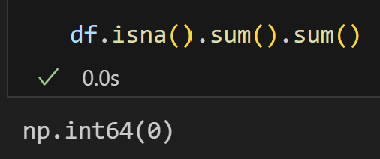
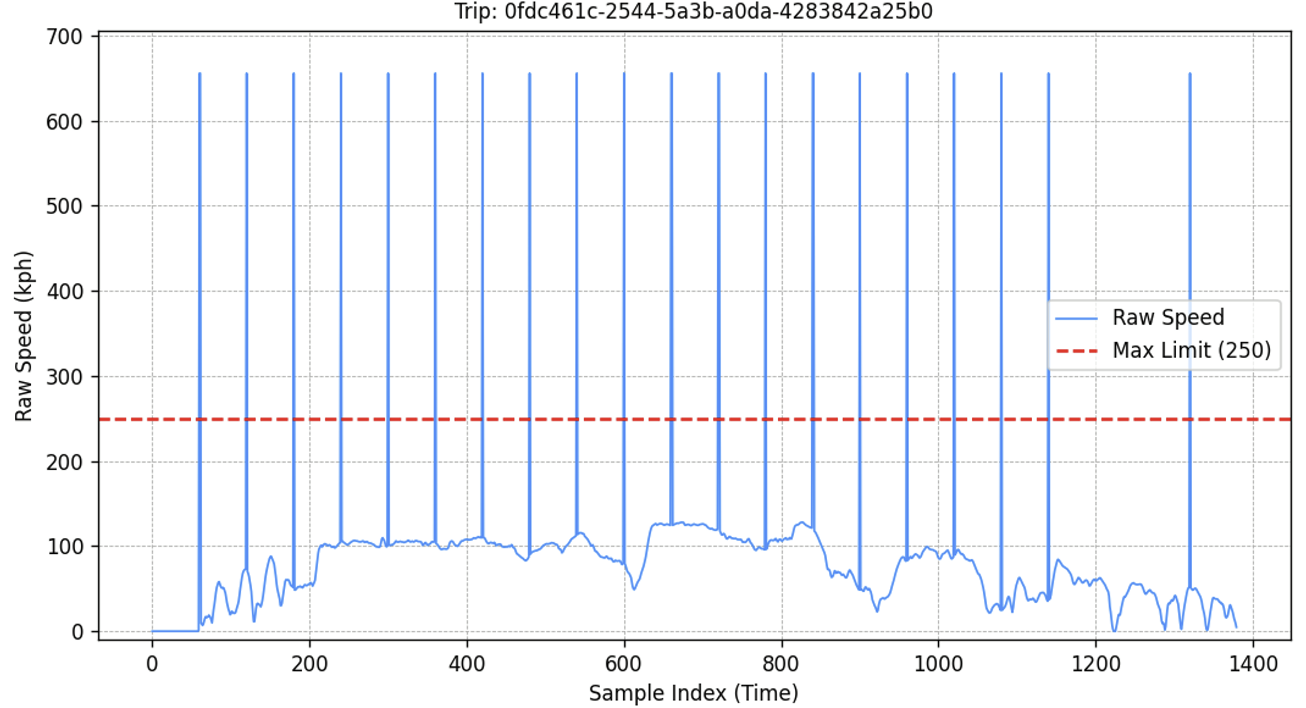
Preprocess
NaN aliases.
+3,000 lines of code.
Notes:
No missing values- but (yes, but) null island, speed, altitude.

Slide 17
Segmentation
Single trip per driver.
Multiple trips per driver multiple segments per trip.
Variable durations: e.g., 39 min 13, 11, 15 min.
No stops of 3+ minutes.
No timestamp “jumps”.
Notes:
Due to privacy constraints, the dataset included only one trip per driver. To overcome this challenge, we segmented each trip such that individual segments emulate standalone trips by the same driver. So instead of having multiple trips per driver, we had multiple segments per trip.
We tried to make the segmentation as realistic as possible. Accordingly, trips were segmented into varied lengths by dividing them into 10-minute driving segments, with random partitioning of the remainder. For example, a 39-minute trip could be divided into segments of 13, 11, and 15 minutes each.
Additionally, we ensured that segments do not contain 3+ minutes without active driving and only include valid 1-minute jumps between samples.

Slide 18
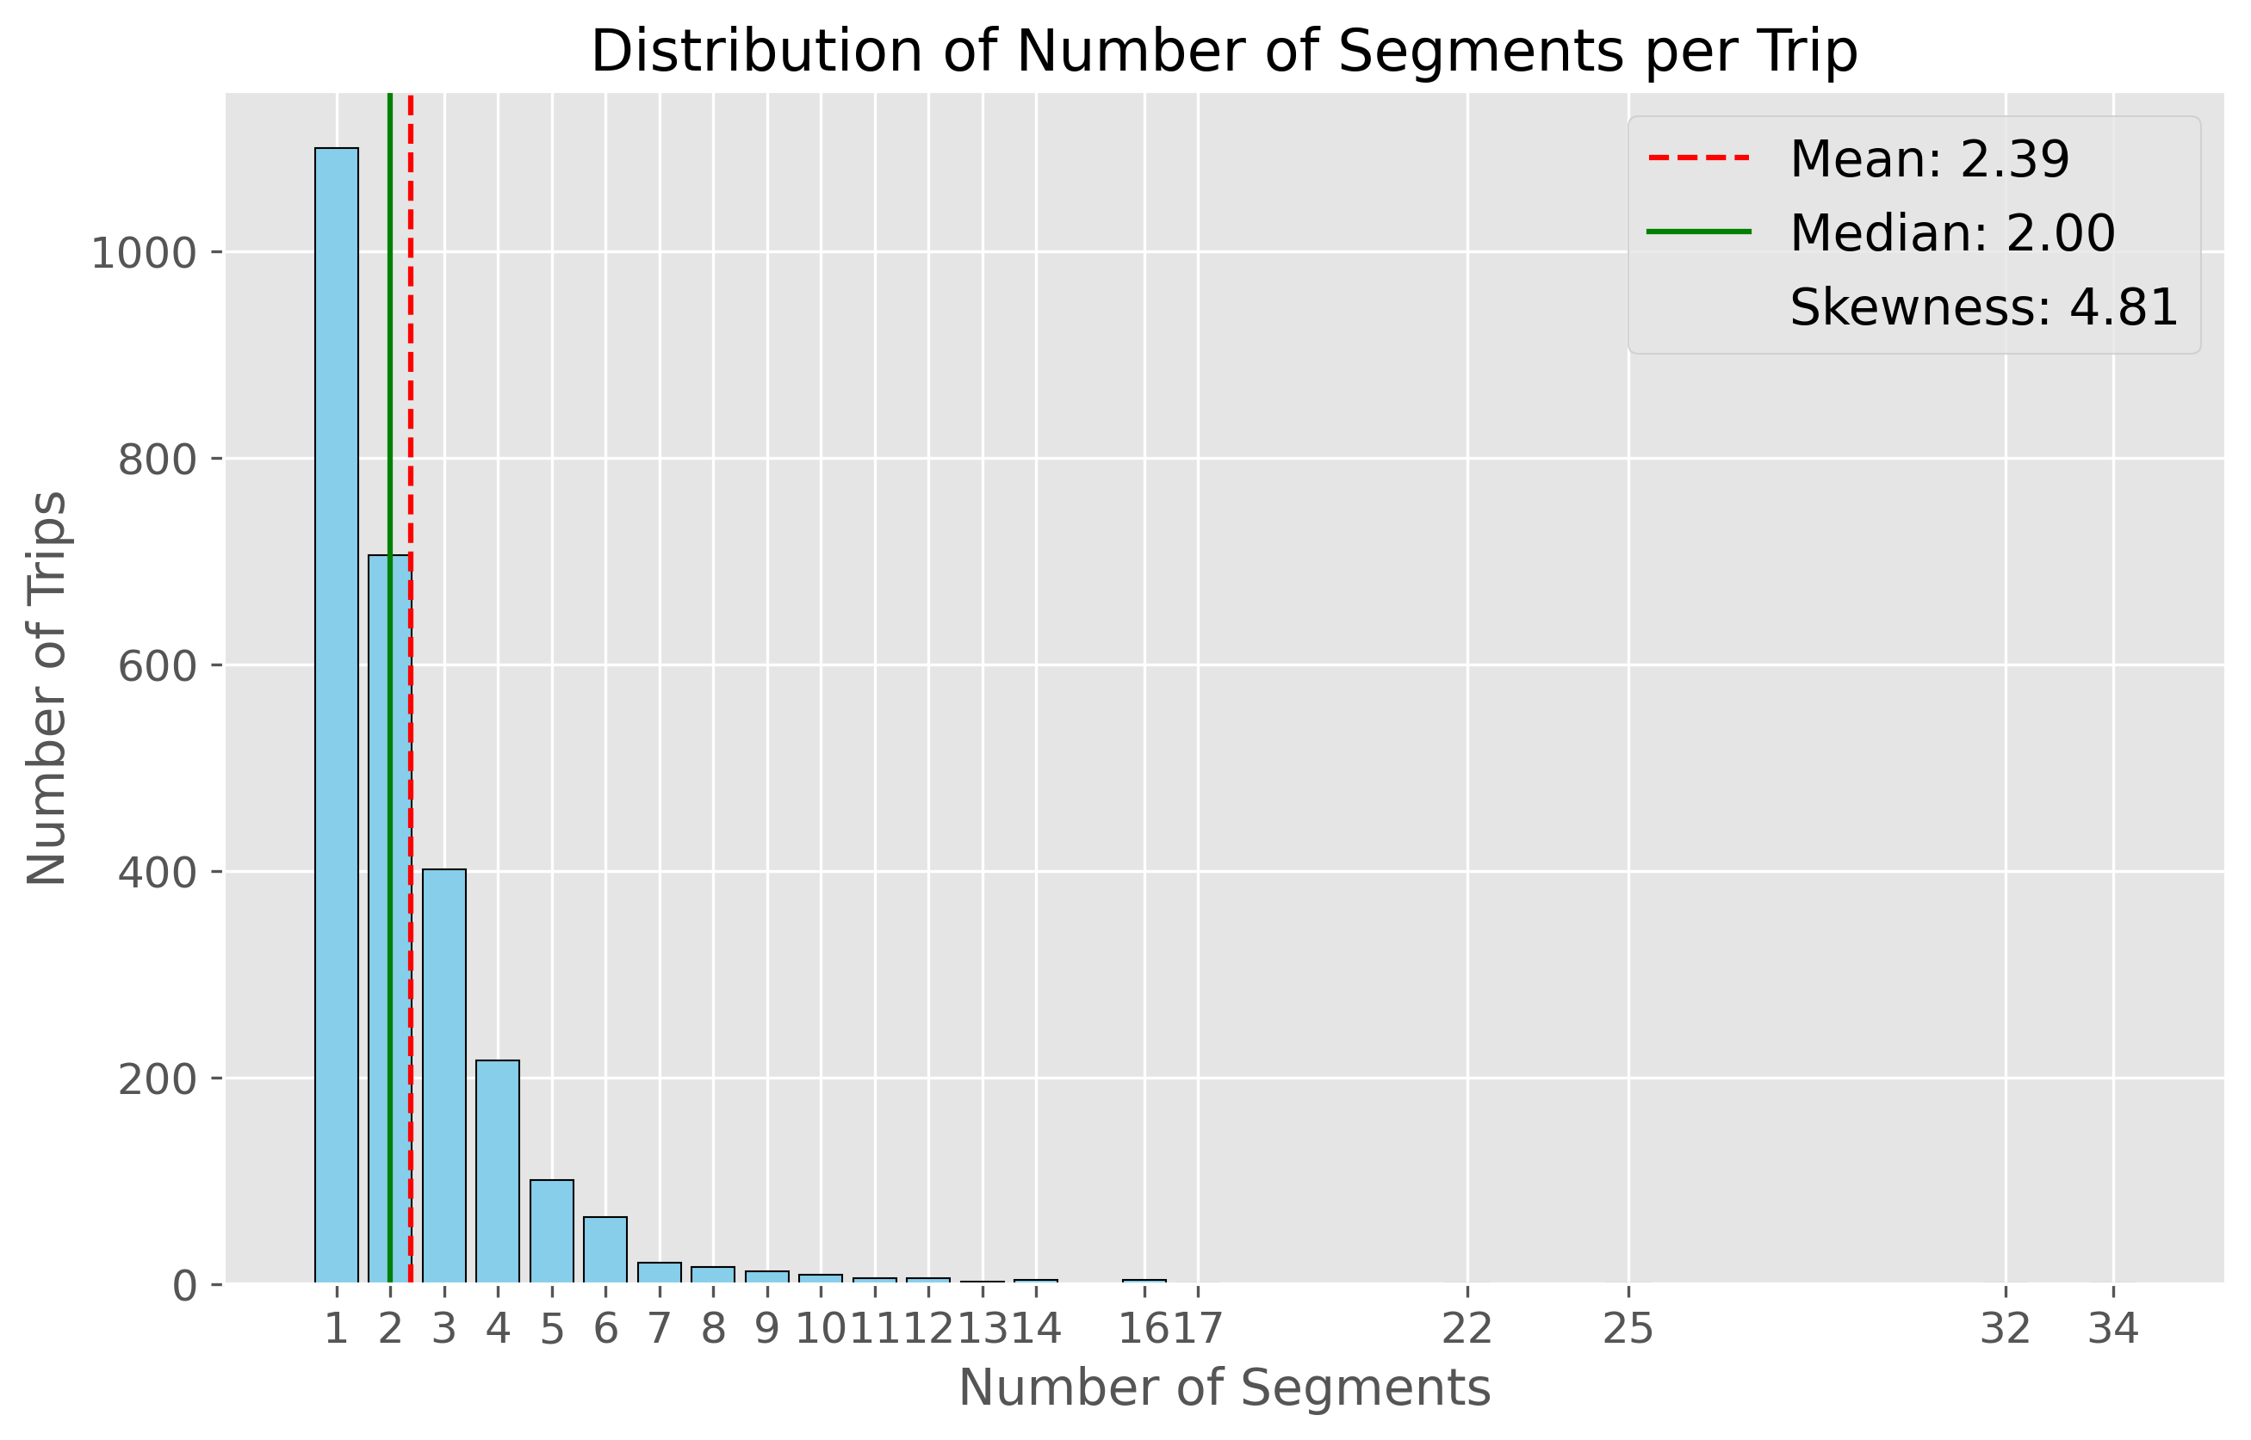
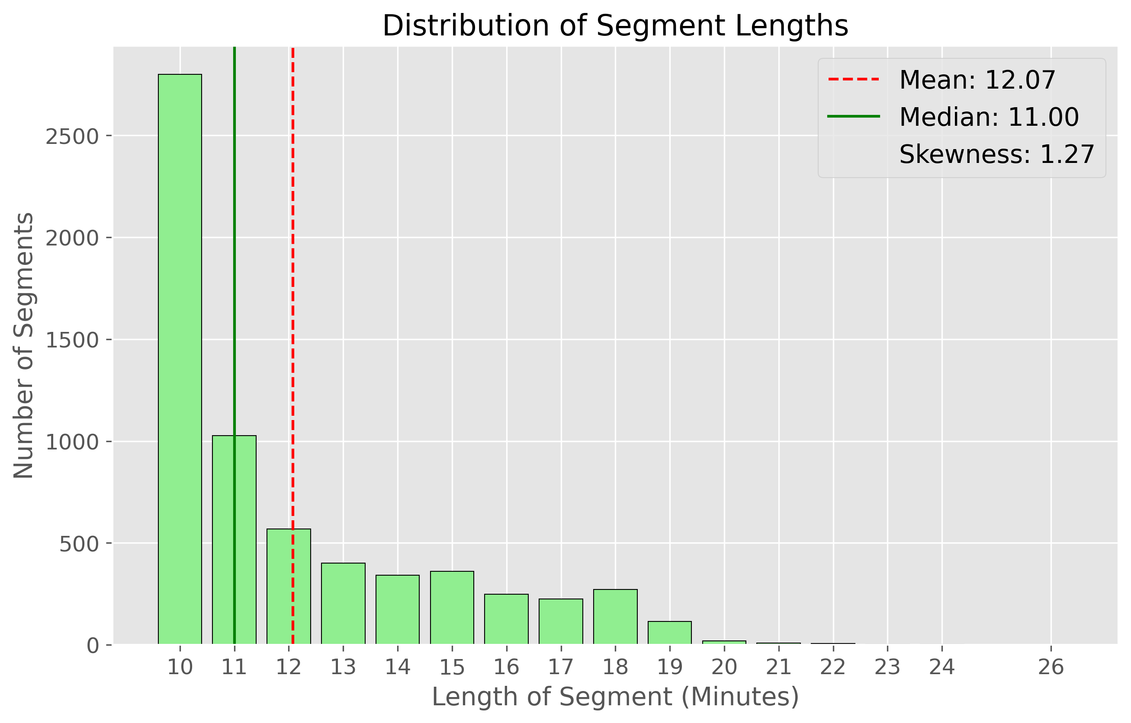
Segmentation
2,679 trips 6,398 segments.
10-19 driving min (+transient stops).
Avg 2.4; 57% ≥2; 31% ≥3.
Right skewed.
Notes:
We can see here on top the distribution of number of segments per trip and on the bottom the distribution of segments lengths in minutes. After preprocessing we were left with 2,679 trips and they were segmented to a total of 6,398 segments- each 10–19 minutes of driving plus short stops, averaging 12 minutes with right skew. There were 2.4 segments per trip, with 57% of trips having 2+ segments and 31% 3+, with a strong right skew. So overall we have limited number of close to 10 minutes segments per driver.

Slide 19
General Pipeline
Single prediction, at trip start, of the SoC at the destination.
No future leakage: only features known at trip start.
Preprocessing
Trip Segmentation
Feature Extraction
Modeling
Evaluation
Notes:
OK, so our goal was to accurately predict the state of charge at the end of the trips. In order to make predictions realistic, it was crucial to us to strictly use information known at the start of the trip for the predictions, avoiding any future leakage.
The general pipeline was as follows: Preprocessing -> trip segmentation (which I already mentioned) -> feature extraction -> modeling -> evaluation.

Slide 20
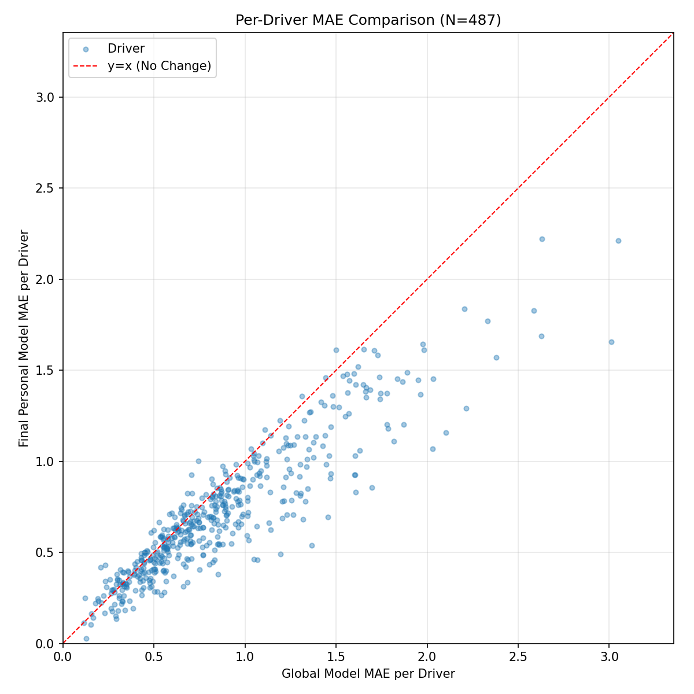
Classical ML
Max/mean/std of segments' speed and its derivatives.
Initial support for incorporating driving behavior features.
Blurs drivers’ behavior.
Notes:
We started with a classical ML approach, that leverages feature engineering to represent driver's driving behavior. For example, we incorporated the Max/ mean/ std of segments’ speed and its derivatives.
We added these aggregations to static features known at segment start and found that incorporating driving behavior features improved model accuracy.
As shown in the plot, all points in the bottom triangle represent drivers whose prediction accuracy improved with these features.
This approach showed initial promise, yet we felt that aggregating high-frequency time series data (speed and altitude) blurred drivers' behavior, preventing a meaningful driver fingerprint.

Slide 21
DL Approach
DL NN❤️raw(-ish) data.
Embedding of driver’s behavior driver fingerprint. in past segments
Notes:
Therefore, we decided to leverage DL NN, which excel at finding hidden patterns in raw-ish data in order to generate driver's fingerprints.
Specifically, the mean embedding of driver’s behavior in past segments serves as the driver's fingerprint. This fingerprint can be used downstream as a feature-- combined with non-behavioral features known at segment start—to predict the driver’s state of charge (SoC) at the end of the segment.

Slide 22
Driver Embedding Features
Driving behavior free from any trip context.
High resolution (1 Hz).
Notes:
As out main goal was to build an embedding space that captures drivers' fingerprint, we ensured that the data fed to the model represents driving behavior free from any trip context like, traffic, weather or road type.
Additionally, we wanted to feed the model high frequency raw-ish time series to let the NN to learn hidden patterns in the data.
Since our only high-frequency data was speed at 1 Hz resolution, the first step was
to further enrich the data.

Slide 23
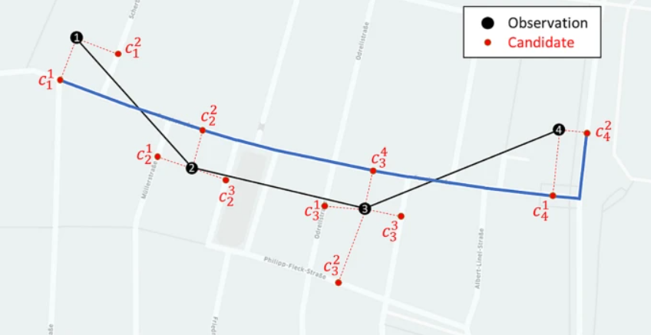
Data Enrichment
Per min GPS segment route (≈ odometer change).
Using speed to “walk” the route 1 Hz GPS.
Open Mateo
Hourly weather data (weather code, precipitation, wind speed etc.)
1 Hz GPS
Open Topo
1 Hz elevation
Open Street Map
1 Hz route descriptors (speed limits, # lanes, road type etc.)
Notes:
First, we fed the per-minute locations of every segment to OSRM- an external API that matched them to a logical route. We ensured the route's total distance was close to the segment's odometer change.
Next, we used the speed data to "walk“ the route- splitting it into 1 Hz coordinates.
We then fed these 1 Hz coordinates to three open APIs. From Open-Meteo we fetched hourly weather data including weather code, precipitation, wind speed etc.) From Open Topo which is a DEM (digital elevation model from satellite imaging), we fetched 1 Hz elevation matching our route, we then validated that the DEM elevation were relatively similar to the elevation we got from the car sensors.
Lastly, from Open StreetMap we fetched 1 Hz route descriptors like speed limits, number of lanes, and road type.

Slide 24
Driver Embedding
2 min,1 min hop (0-120, 60-180 etc.)
Speed and its derivatives.
Turning profile.
Column Name | Meaning
speed_limit_ratio | Vehicle speed divided by road speed limit, indicating compliance or over-speeding.
grade_corrected_accel | Acceleration adjusted for road slope, showing true vehicle effort without hill effects.
jerk_mps3 | Rate of change in acceleration, measuring driving smoothness.
yaw_rate_dps | Speed of vehicle rotation.
yaw_accel_dps2 | Rate of change in turning speed.
centripetal_jerk_mps3 | Rate of change in turning forces.
lat_accel_signed_mps2 | Side-to-side force with direction (left/right), showing cornering intensity.
Notes:
The features that were eventually fed to the embedding model were: … , all at 1 Hz resolution. To ensure that the model will contain a lot of samples with rich data,
We split the 1 Hz enriched dataset to windows of two minutes with hop of minute, 0-120, 60-180 etc.

Slide 25
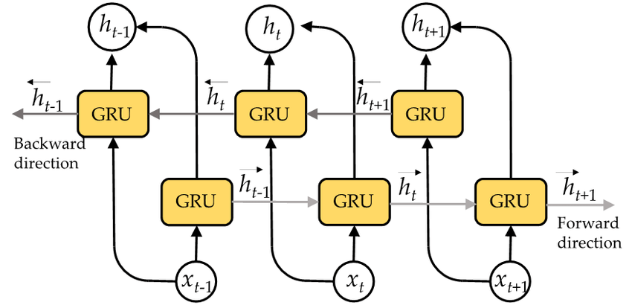
Driver Embedding
Feature Extraction: 1D Convolutional layers (2x Conv1D + BatchNorm + ReLU + Dropout) to capture local temporal patterns.
Sequential Modeling: Bidirectional GRU to encode long-range dependencies in the sequence.
Projection & Normalization: Linear layer to output embedding (128-dim), L2-normalized for cosine similarity.
Input → CNN → GRU → Pool → Linear → Normalized Embedding

Slide 26
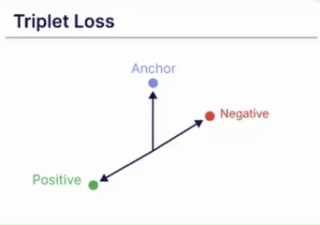
Triplet Loss
L(a,p,n) = max{d(a​, p​) − d(a​, n​) + margin, 0}
Anchor(a)
Positive(p) = same driver different segment
Negative(n) = different driver
Notes:
Specifically, we implemented a Triplet loss-based driver embedding model.
As we learned, Triplet loss operates on triplets of data points: an "anchor", a "positive" example (similar to the anchor), and a "negative" example (dissimilar to the anchor). In our case, positive examples are driving windows from the same driver but from a different segment, and the negatives are driving windows from different drivers. The goal is to train a model to embed these points in a space where the distance between the anchor and positive is smaller than the distance between the anchor and the negative.
L(a,p,n)=max{d(ai​,pi​)−d(ai​,ni​)+margin,0}

Slide 27
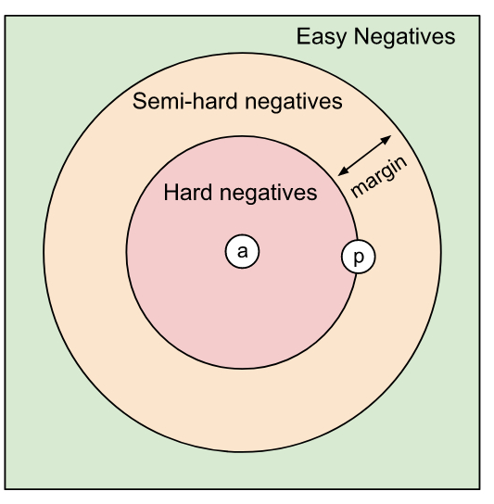
Hard Negatives
Far negatives no learning.
Different driver same context hard negative.
Context vector DB
Notes:
A known limitation of Triplet-loss is that if we naively build the triplets, many the negatives will already be far enough from the anchor. These are known as easy triplets, and they do not contribute to training. Including them can often cause the network outputs to collapse to zero. Accordingly, we need to choose hard negatives that are close to the anchor.
In our case, hard negatives are driving windows that share the anchor's environment or context. Therefore, we built a vector database from the driving windows context. We first encoded the context feature including the enriched features like car model battery type, odometer, is weekend, hour of the day, the Weather code etc. We gave the features weights according to how influential we think they are. That way we were able to fetch from the database driving windows that as context that is most similar to the anchor context, forcing the embedding model to actually learn.

Slide 28
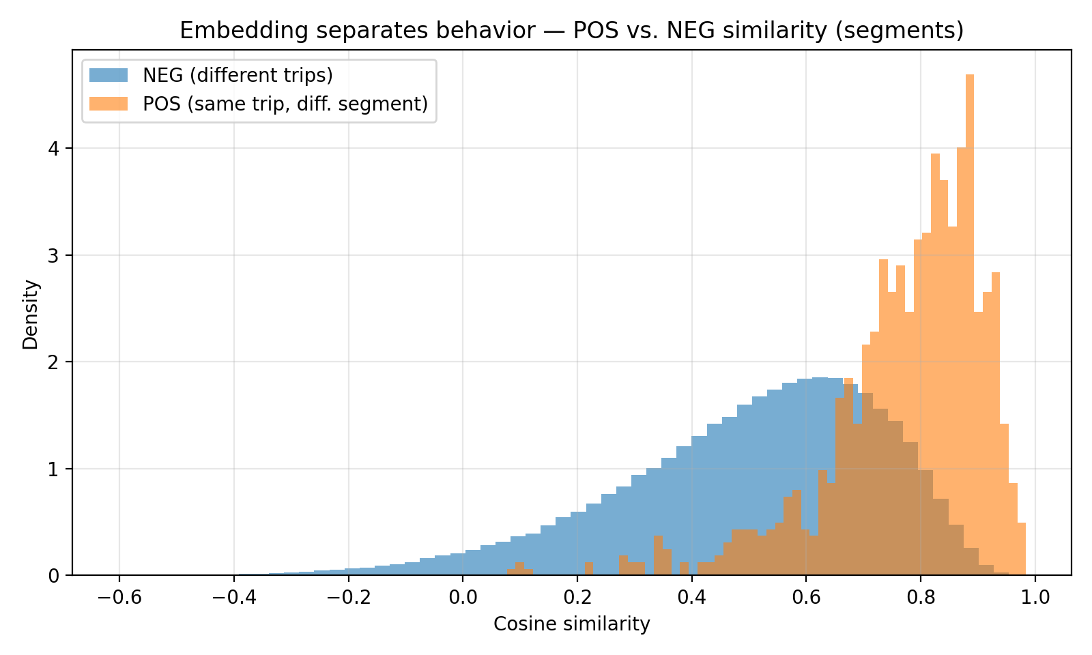
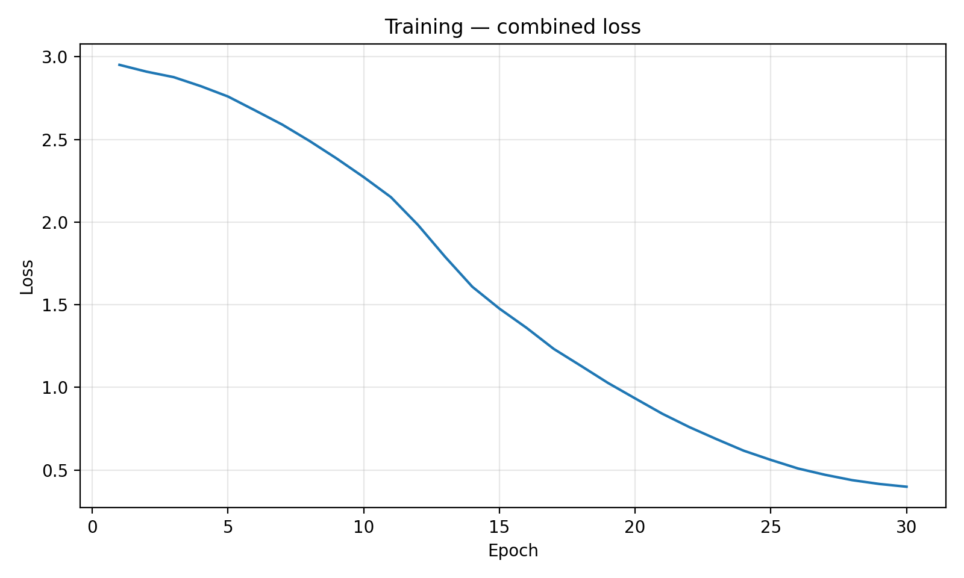
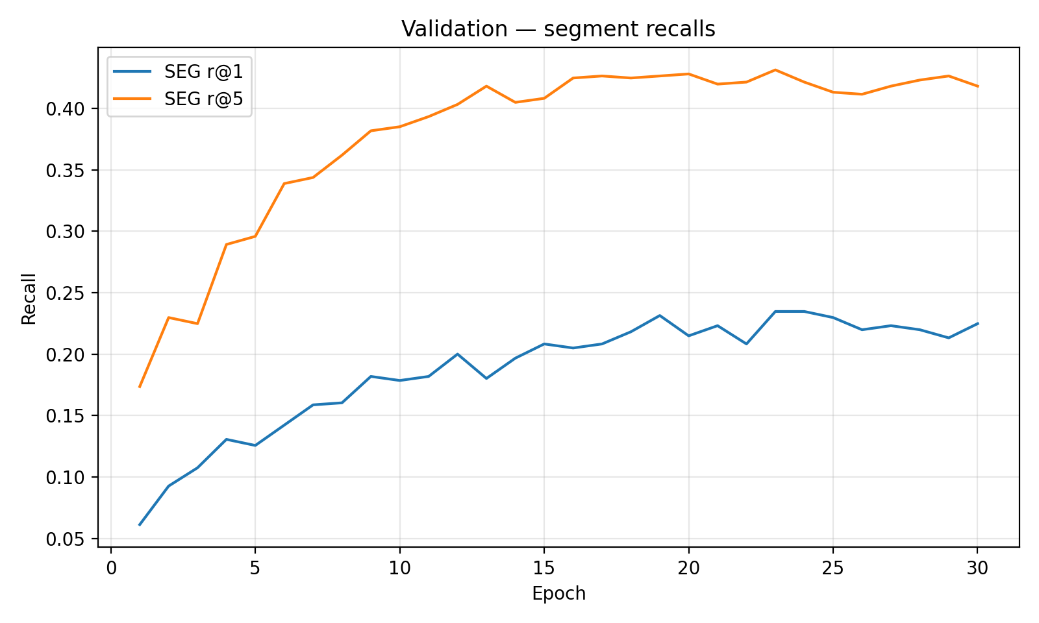
Driver Embedding

Slide 29
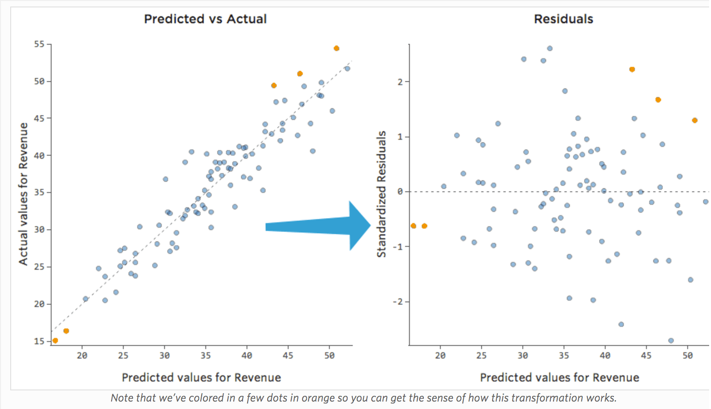
Residual Model
Global model: t₀ features end of seg SoC.
Residual model: predicts the global model errors.

Slide 30
Residual Models
Global model only (no residual).
Driver fingerprint.
Aggregation of behavioral features.
Driver fingerprint + Aggregation model.

Slide 31
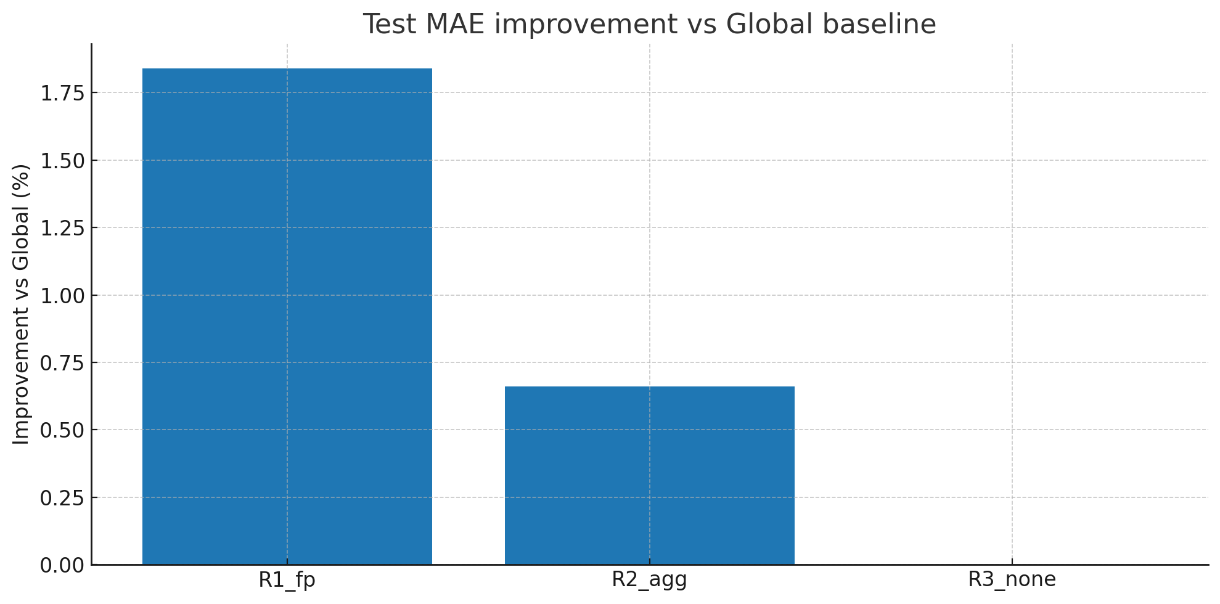
Results

Slide 32
Future work
More data.
Multiple trips per driver.
Actual production model.
Online predictions.
Notes:
Future work should that this pipeline with more data. And importantly, with dataset containing multiple trips per driver. Additionally, here we did not have actual access to the production model, so we had to simulate it. Incorporating the production model is another crucial step. Another step forward would be testing the online adaption of the model with past data from the current trip.

Slide 33
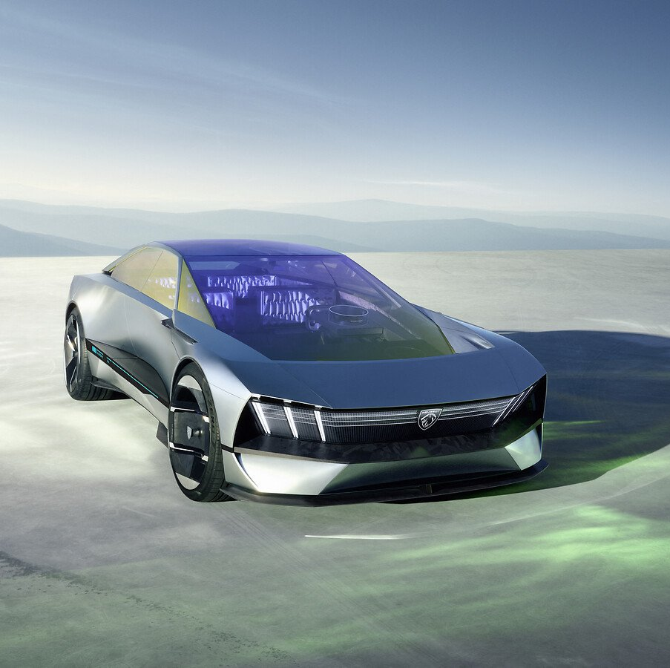
Thanks! Questions?

